Slide 1

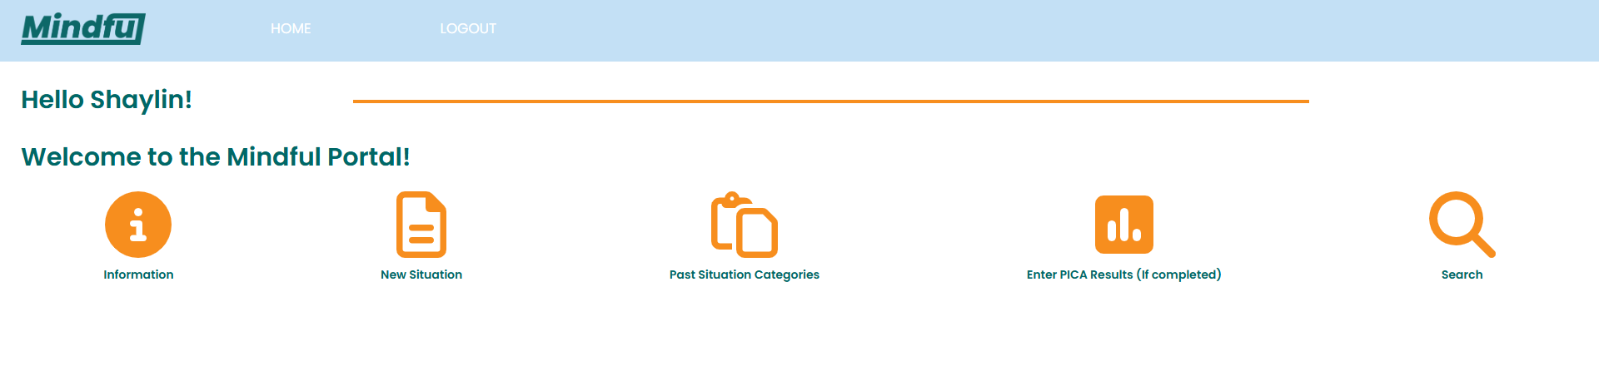
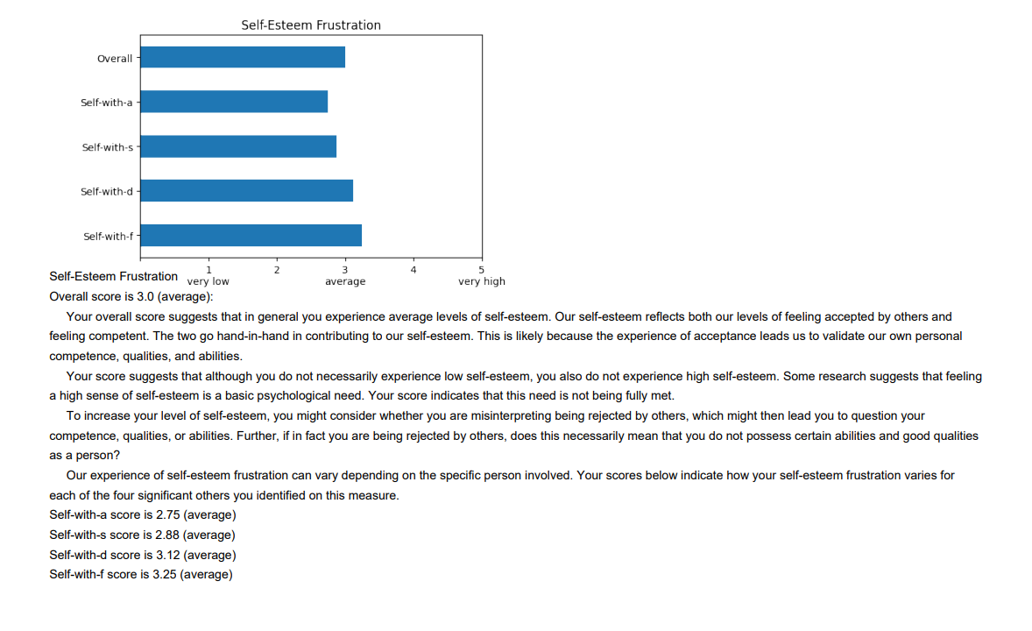
PICA Survey & Mobile Self Monitoring System Sponsor: WSU Psychology Clinic Mentors: Dr. Walter Scott and Belinda Lin Jiaming Chu, Christian Manangan, Shaylin Smith
Abstract
Digital solution to advance mental health treatment
Tool to gather more data about how temperament affects treatment response
Connects users’ personal reflections with actionable insights for clinicians
Supports both in-person and remote monitoring of patient emotional patterns
Solution
PICA (Person in Context Assessment) measures the personality structure of the user and utilizes Flask to produce the feedback report
Mobile app allows doctor to monitor the patient’s temperament as well as their daily emotional events
App allows users to reflect if their situational “if” produces a coherent “then” pattern of thinking, feeling, and behaving.
The user can group each emotional event into categories
Impact
Allows doctors to better understand their patients and create stronger treatment plans
Helps users to get a better understanding of themselves and their personality structure
Gathers more data about how a patient’s temperament affects their response to treatment
Features/Functionality
Automatically sends PICA results report to user’s email
Allow users to opt in for certain parts of the assessment
Supports full customization of emotional categories in-app, allowing users to rename, delete, merge, or move specific surveys between categories
Improved report layout for better understanding of results
Future Work
Create a more sophisticated clustering algorithm for emotional situations
Integrate PICA into mobile app
Glossary
MongoDB Atlas: A cloud-based NoSQL database used to securely store survey and emotional pattern data
PythonAnywhere: A cloud platform used to host and deploy the web application
Technologies
Hosted on PythonAnywhere
Database: MongoDB Atlas
Coded with Flask and Python
Acknowledgements
Dr. Scott, Belinda Lin, Parteek Kumar
PICA Software Development Unit

